Slide 1

CIGARS

Slide 2


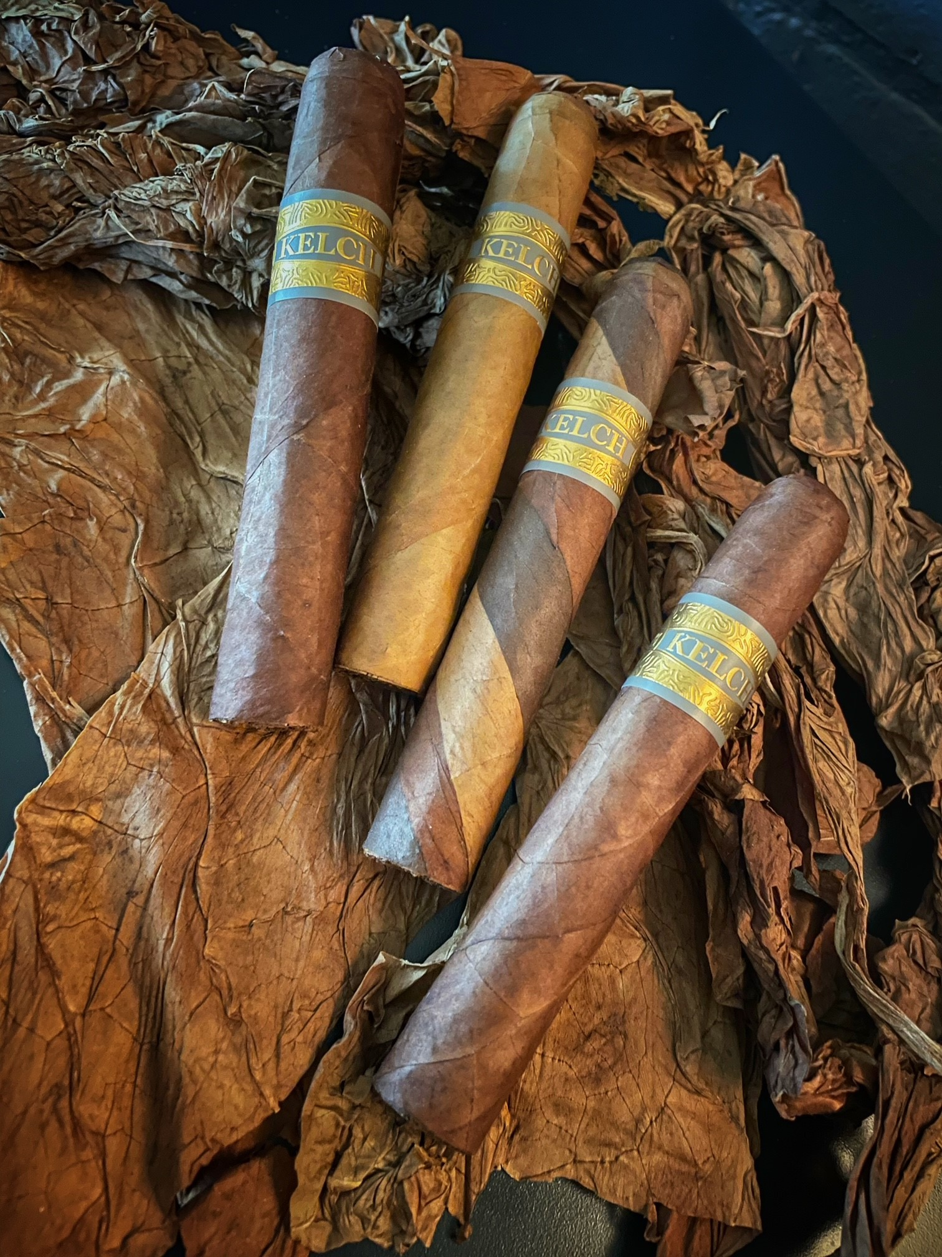

Slide 3
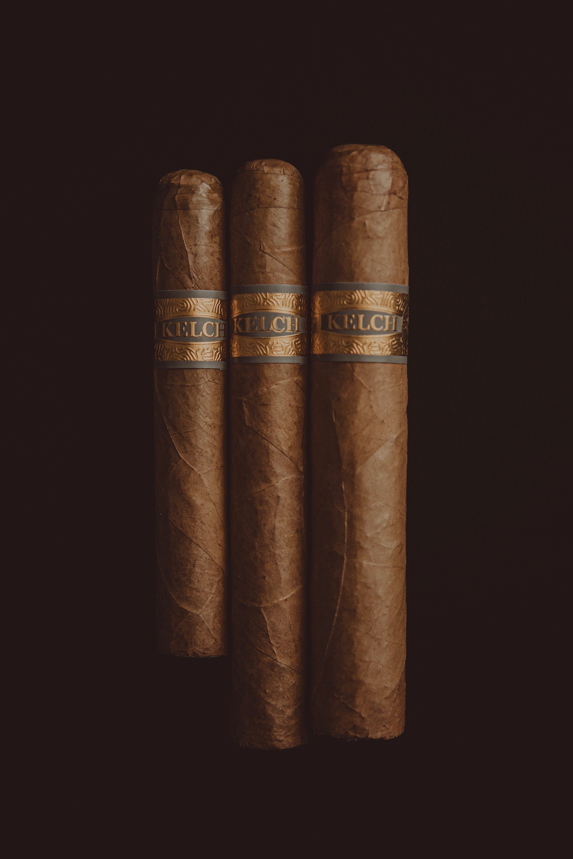
1997
Wrapper: Habano
Binder: Cubano Criollo 98
Fliier: Piloto Cubano, Corojo, Criollo 98
Vitola’s: Robusto, Toro, Gordo

Slide 4
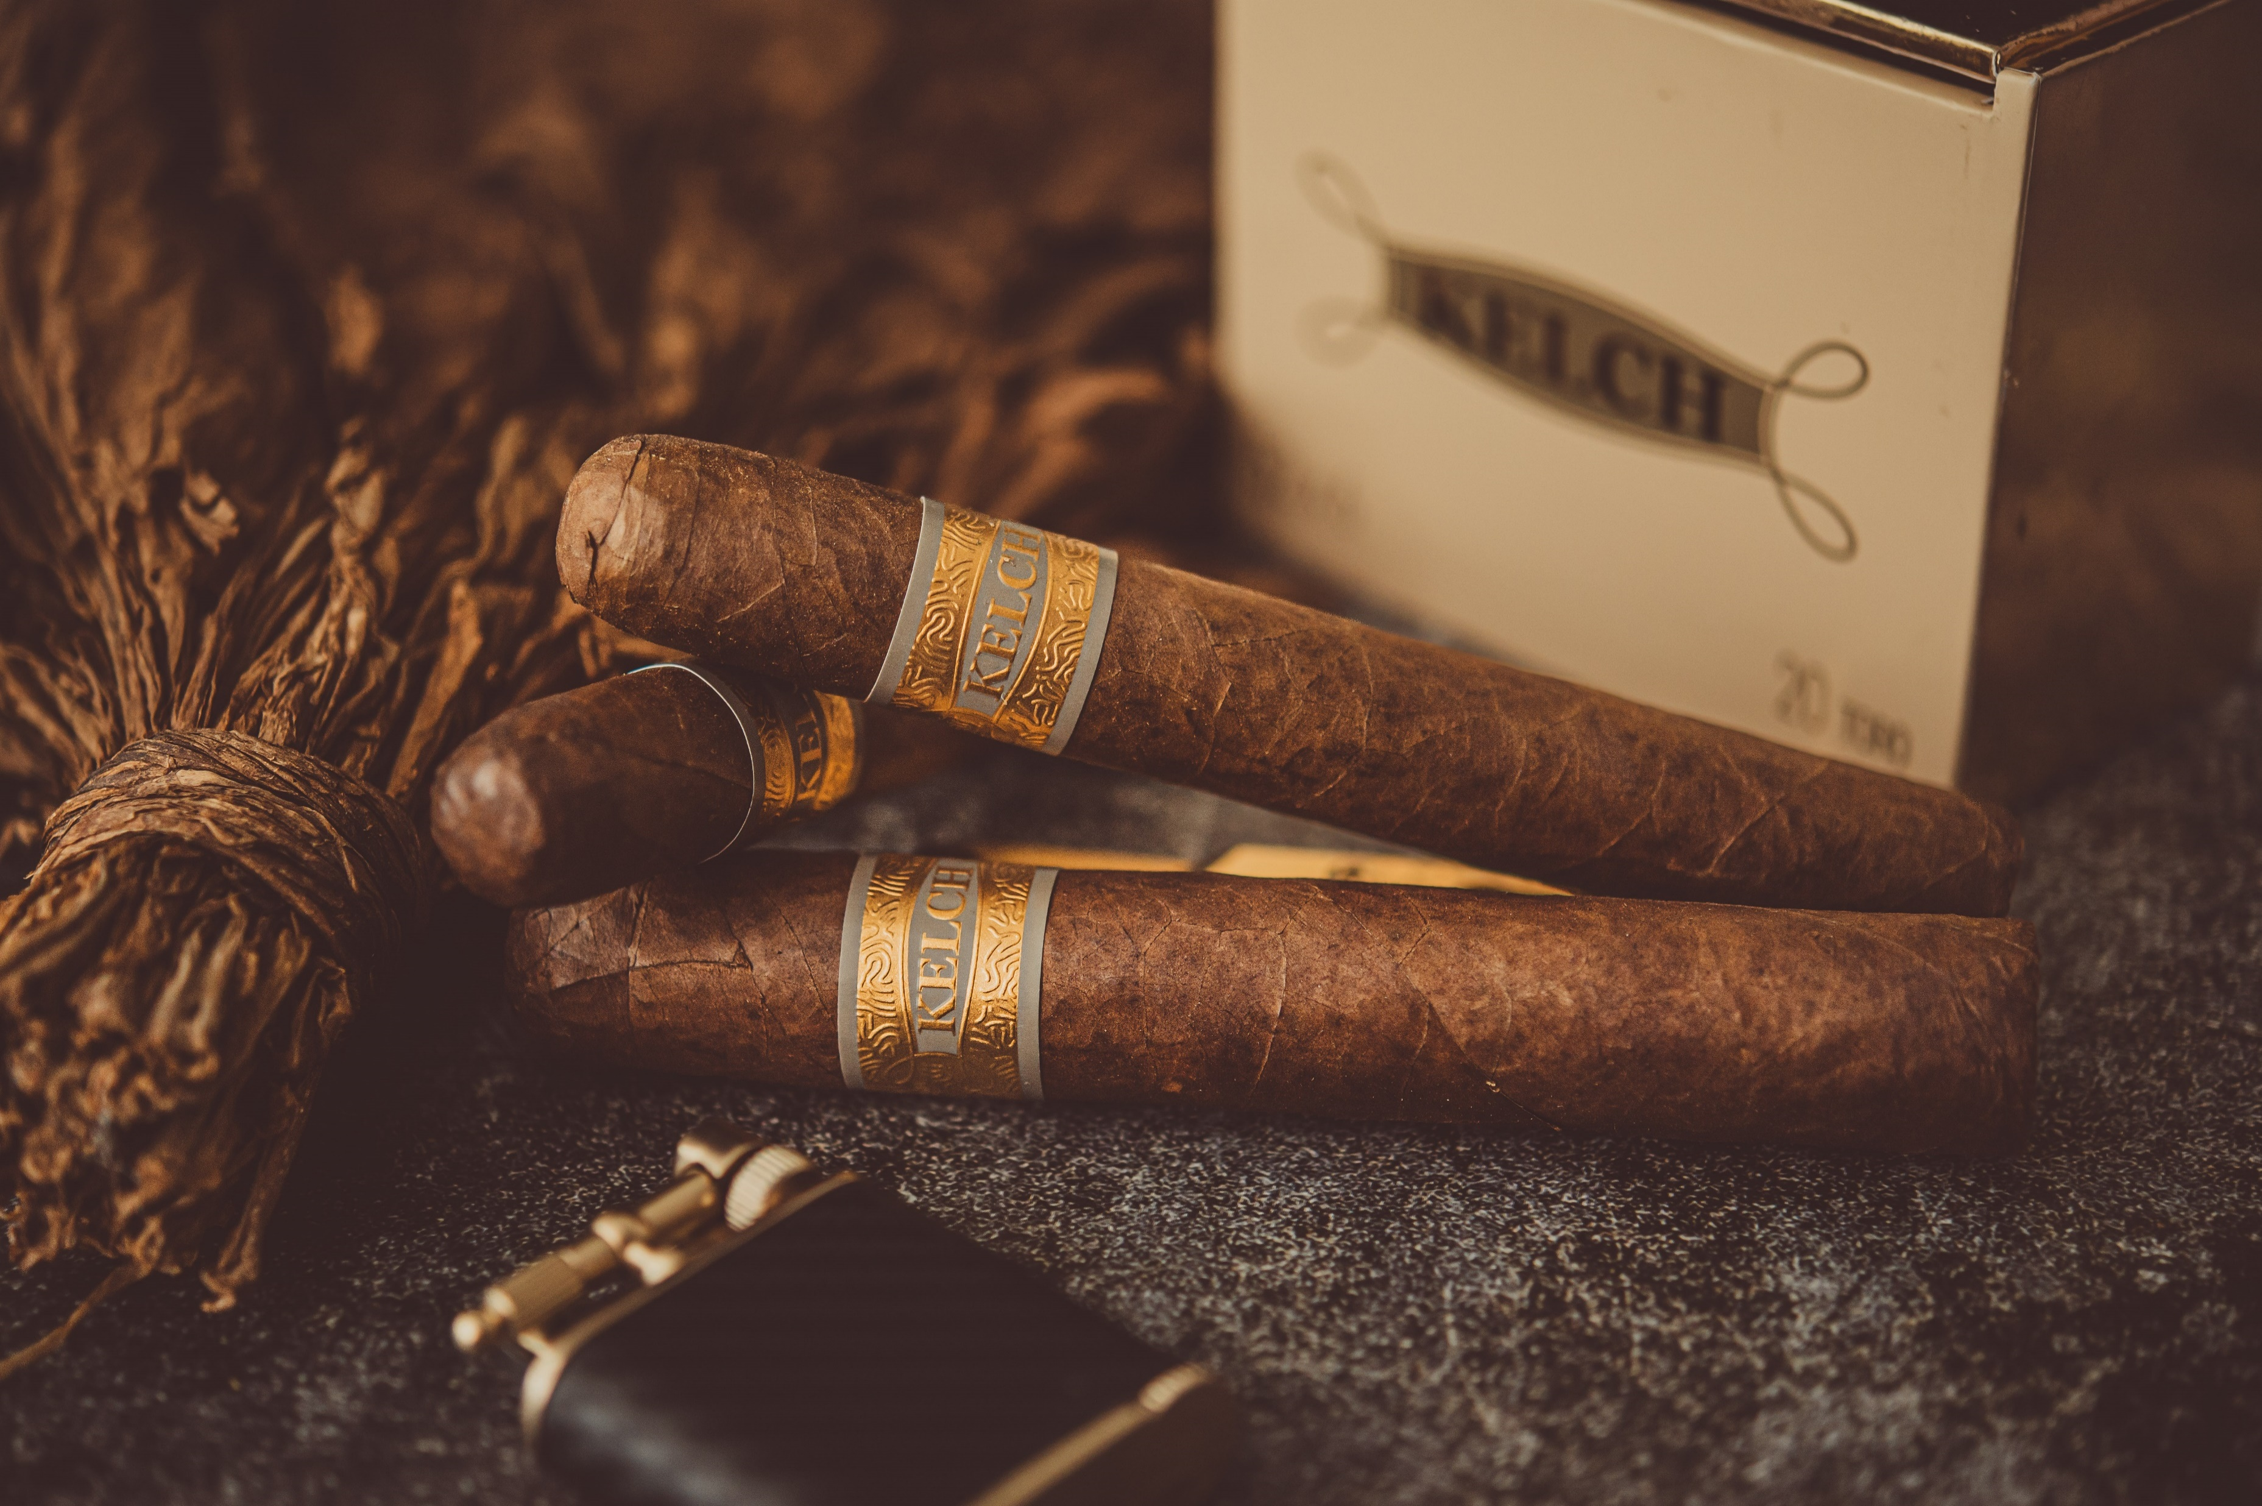

Slide 5
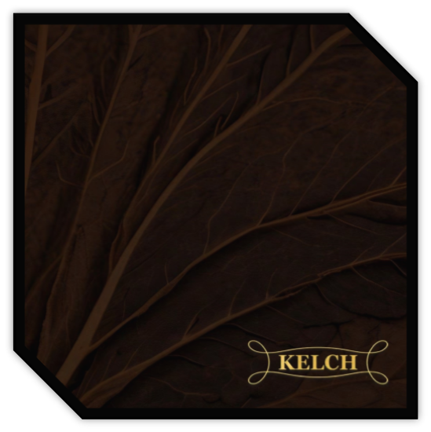
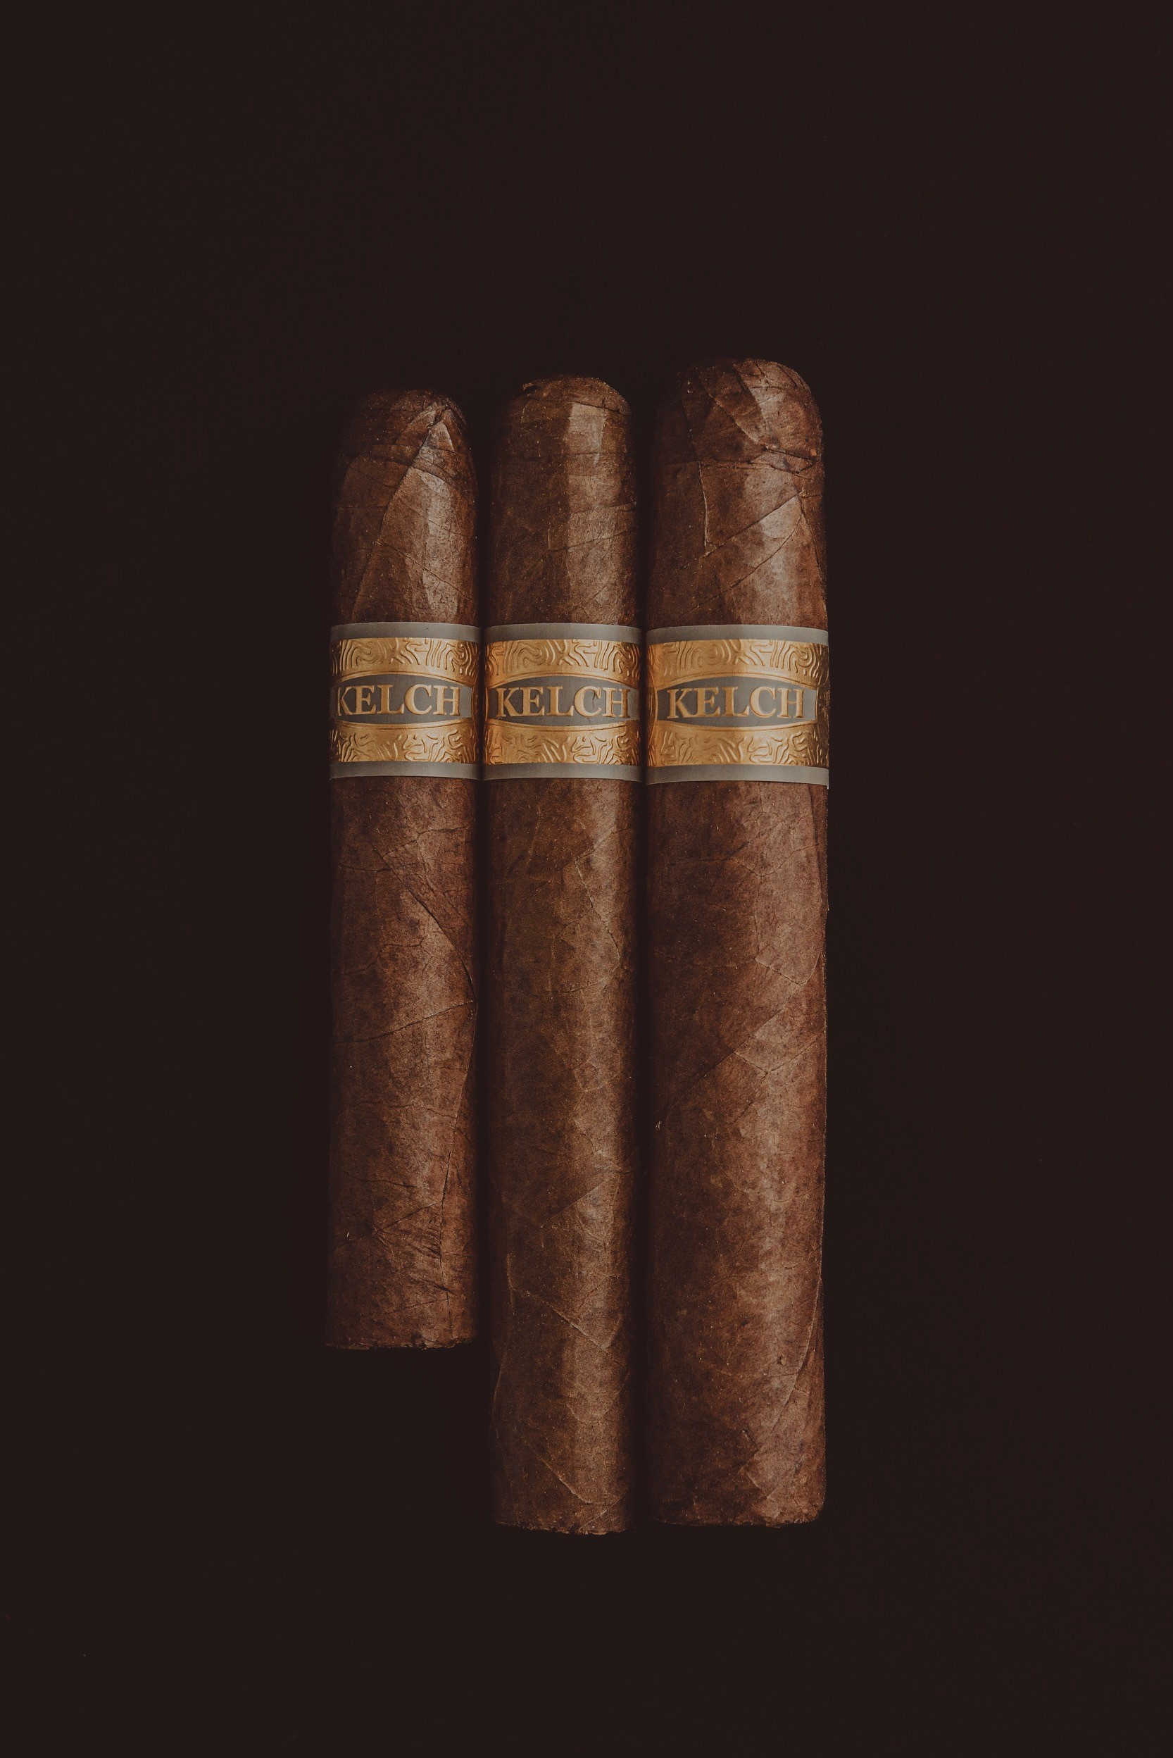
262
Wrapper: Connecticut Ecuador
Binder: Connecticut Ecuador
Filler: Nicaragua Jalapa y Condega, Olor Dominicano & HVA
Vitola’s: Robusto, Toro, Gordo

Slide 6
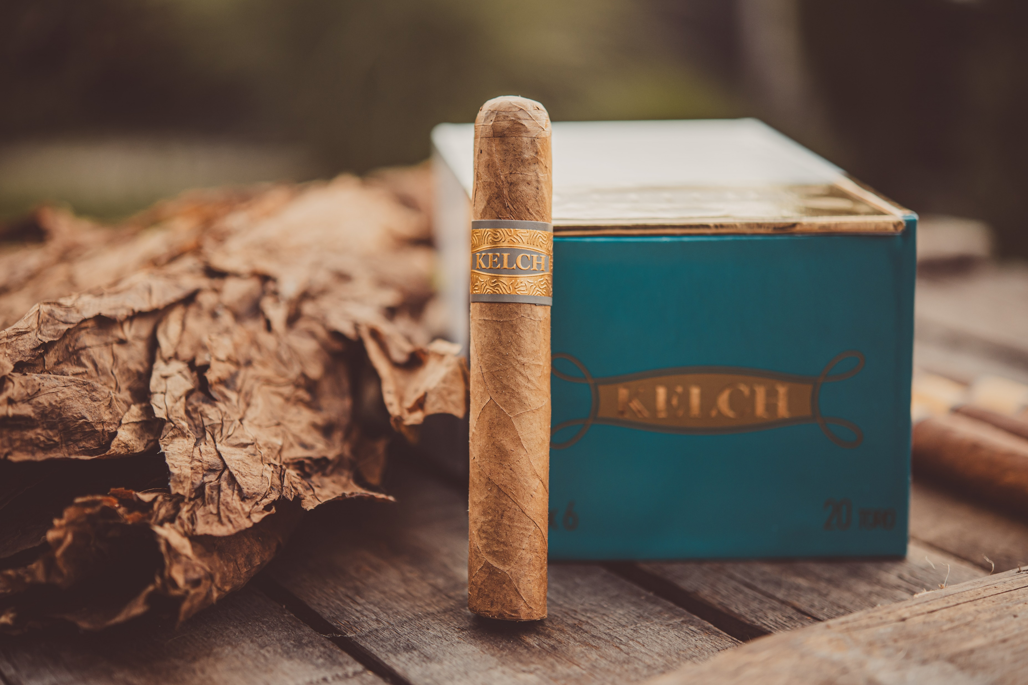

Slide 7
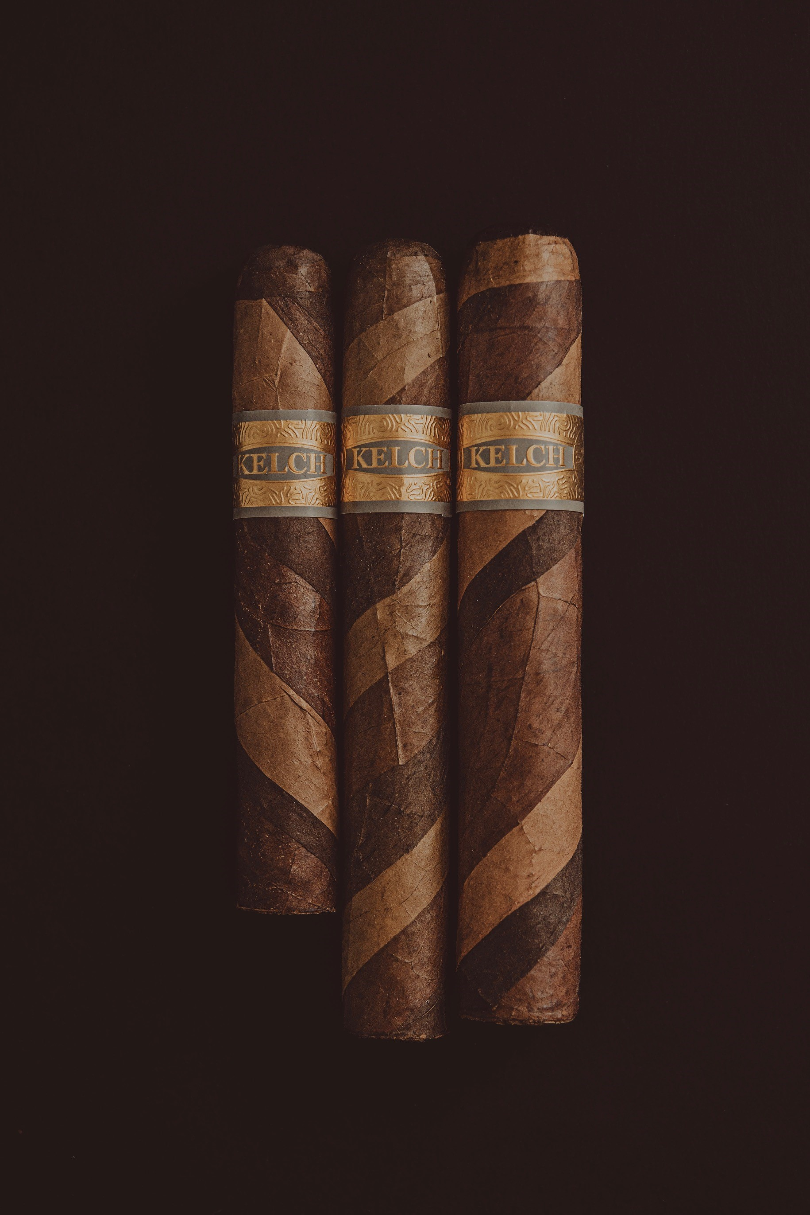
2017
Wrapper: Habano, Mexico y Connecticut
Binder: Indonesia
Filler: Special blend
Vitola’s: Robusto, Toro, Gordo

Slide 8
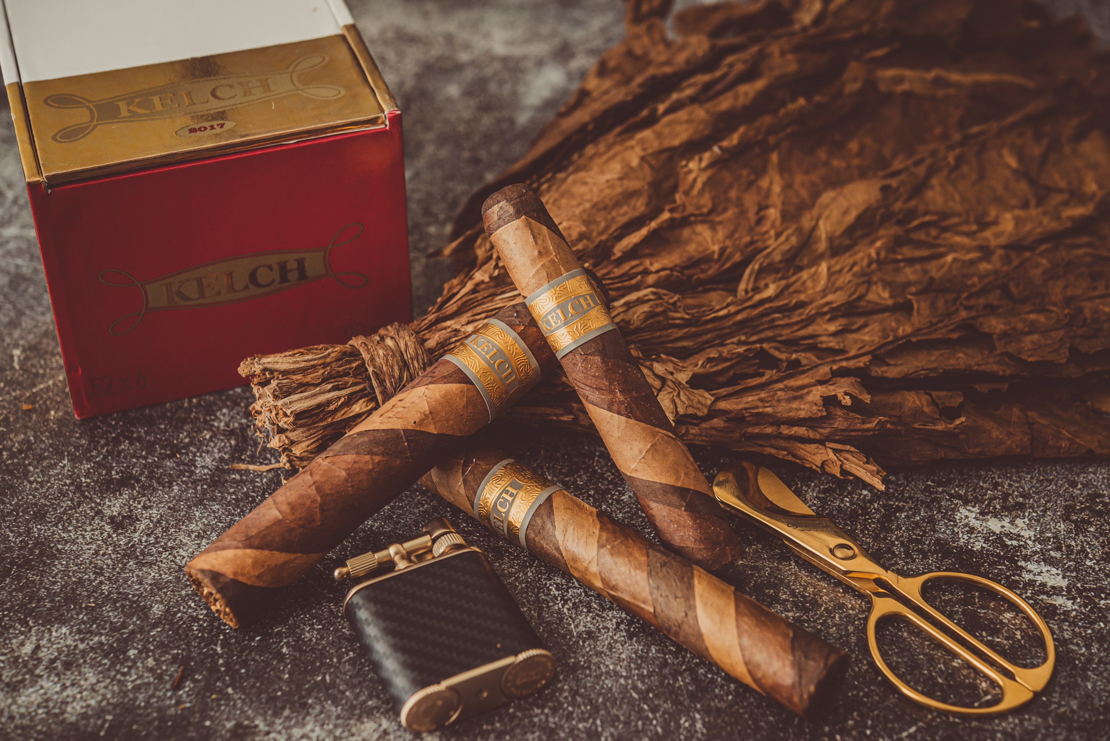

Slide 9

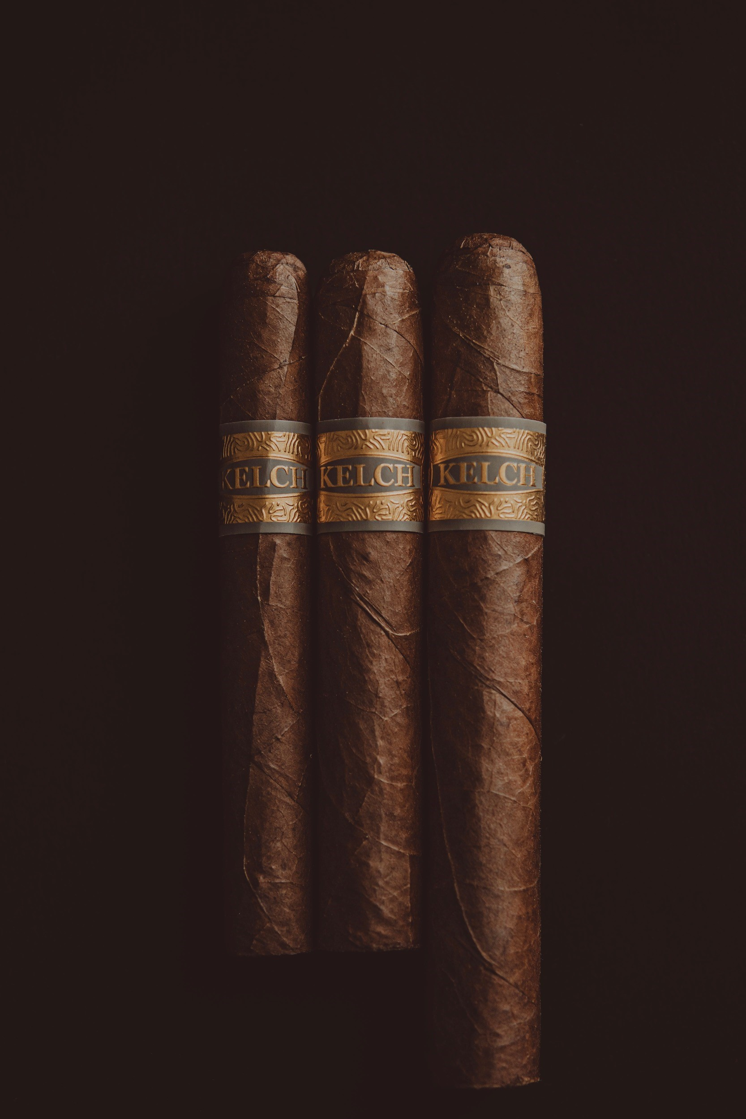
Legacy
Wrapper: Ecuador
Binder: Mexico
Filler: Criollo 98, Pennsylvania, Dominican Chago Diaz
Vitola’s: Corona, Robusto, Toro

Slide 10
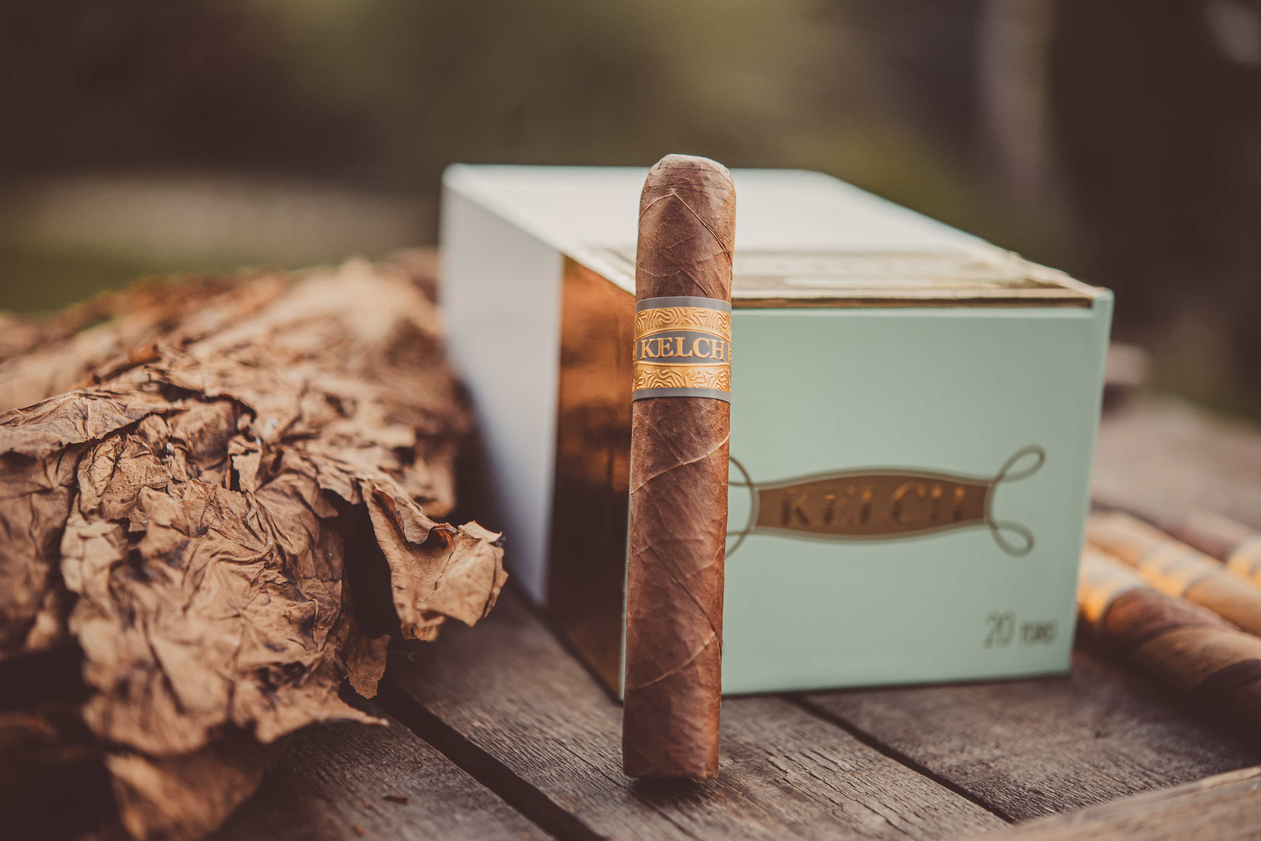

Slide 11

SINCE 2024

